Slide 1
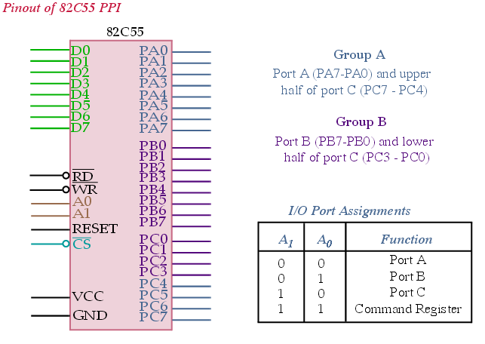
Basic Description of 82C55
The 82C55 is a very popular, cost effetive interfacing component for μP.
It has 24 pins and three I/O ports.
Group-A consists of Port-A and upper half of Port-C.
Group-B consists of Port-B and lower half of Port-C.
Register selection is done by A1, A0 pins.
It can operate in three distinct modes of operations:
Mode-0 (simple I/O)
Mode-1 (strobed I/O)
Mode-2 (bidirectional I/O)

Slide 2
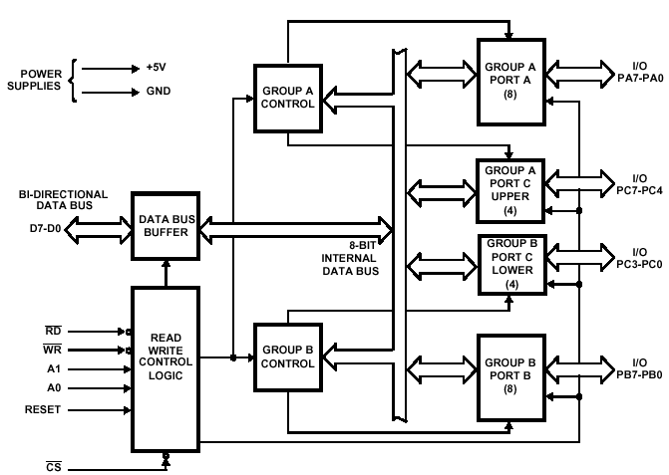
Block Diagram of 82C55

Slide 3
Operating Modes
Mode-0 Operation:
It causes the 82C55 to function as either a buffered input device or as a latched output device. For example, 82C55 can be interfaced with LED display (latched output) or with keyboard (buffered input).
Mode-1 Operation:
It causes Port-A and/or Port-B to function as latching input device. Port-C is used for control or handshaking signals in this mode.
Mode-2 Operation:
It allows only group-A. Here, Port-A becomes bidirectional, allowing data to be transmitted and received over the same eight wires.

Slide 4
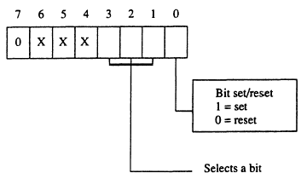
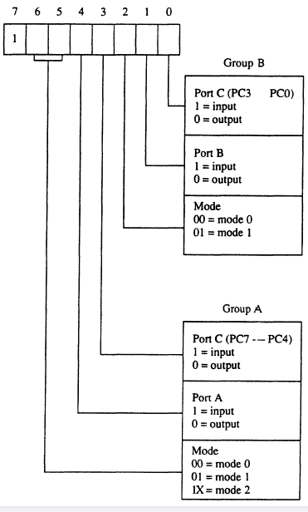
Programming 82C55
Command Byte B
Command Byte A
The Command Byte A functions for group-A and
Group-B and Command Byte B sets or resets the bits of
Port-C only if 82C55 is programmed in mode-1 or mode-2.
Group-A can operate in all three modes while Group-B
can operate in only mode-0 and in mode-1.

Slide 5
Control Word and Programming 82C55
Control Word
It is a word stored in a register named control register used to control the operation of a program of a digital device.
Find the control word by keeping c4 pin reset in C port.
Find the control word for PA=out, PB=in, PC0-PC3=in, PC4-PC7=out.
1 | 0 | 0 | 0 | 0 | 0 | 1 | 1
Therefore, Control Word = 83H

Slide 6
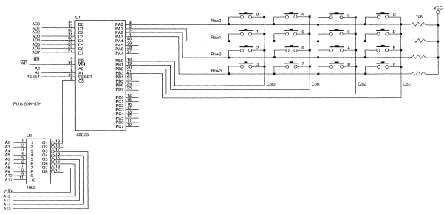
Interfacing a 4×4 Key-Board
Electrical contacts in mechanical push button
switches often make and break contacts several
times when the button is first pushed. This is called
Debouncing.
A debouncing circuit removes the resulting ripple
signal and provides a clean transition to its output.
Port-A is programmed to read the rows while Port-B is programmed
to select a column. If 1110 is output to Port-B, column-0 has logic-0.
So the four keys of column-0 are selected. Now, if a key is pressed in
column-0, corresponding Port-A line can detect the stroke.

Slide 7
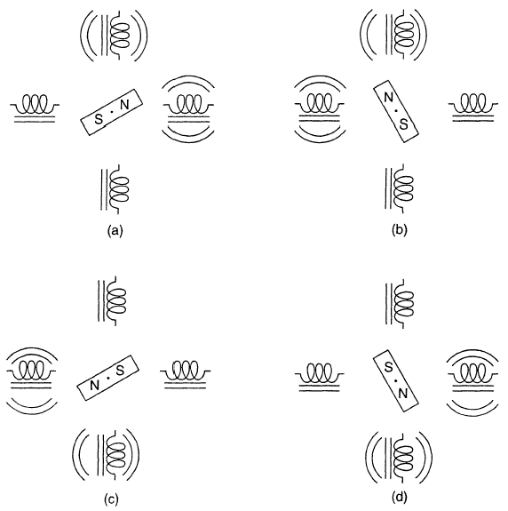
Operation of a Stepper Motor
A stepper motor is a digital
motor as it moves in discrete
steps.
Figure(a) shows that the motor
is repelled by the same pole
and moves a step to 45º.
Then it is attracted by the
different pole and moves
another step to 135º.
Thus it also moves
Upto 225º and 315º.

Slide 8
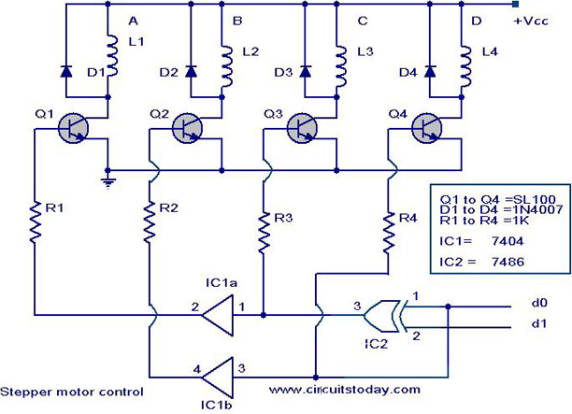
Circuit of Stepper Motor

Slide 9
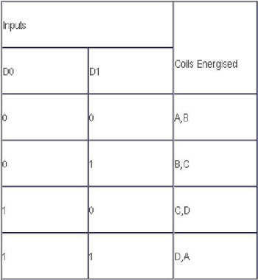
Truth Table

Slide 10
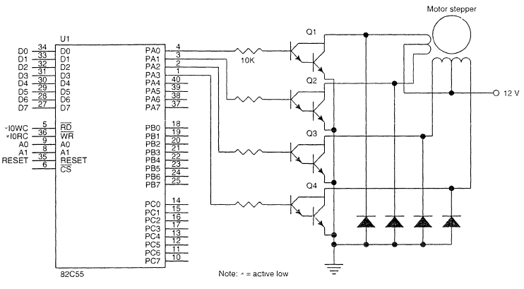
Interfacing Stepper Motor through 82C55
# In order to flow high current through the coils, darlington amplifiers are used in stepper motor interfacing.
# Since a motor is an inductive load, it will produce a back EMF which could damage second transistor.
The single diode prevents the damage by sorting out the back EMF.

Slide 11
Controlling Stepper Motor in its Full Step Operation
The following procedure controls the stepper motor’s full step operation
where the motor is interfaced to the port A of 82C55.

Slide 12
Mode-1 and Mode-2 Operation of 82C55.
Mode-1 Strobed Input
Mode-1 Strobed Output
Mode-2 Bidirectional Input

Slide 13
Mode of Strobed input
Mode 1 operation causes port A and/or port B to function as latching input devices. This allows external data to be stored into the port until the microprocessor is ready to retrieve it.
Port C is also used in mode 1 operation, not for data, but for control or handshaking signals that help operate either or both port A and port B as strobed input ports.

Slide 14
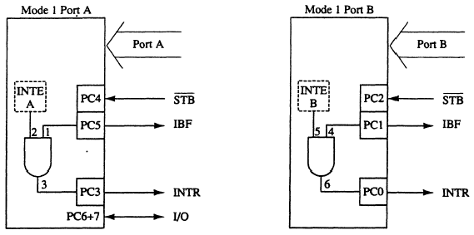
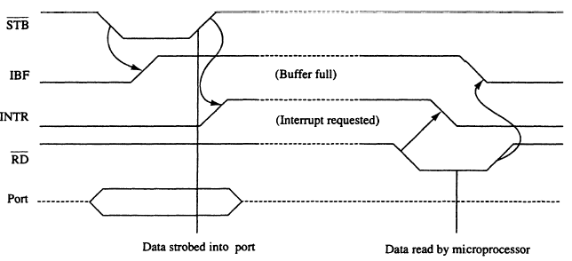
Mode-1 Strobed Input

Slide 15
Timing diagram
The strobed input port captures data from the port pins when the strobe (STB) is activated. The STB signal causes data to be captured in the port and also activates the IBF (input buffer full) and INTR (interrupt request) signals.
Once the microprocessor, through software (IBF) or hardware (INTR), notices that data are strobed into the port, it executes an IN instruction to read the port (RD).
The act of reading the port restores both IBF and INTR to their inactive states until the next datum is strobed into the port.

Slide 16
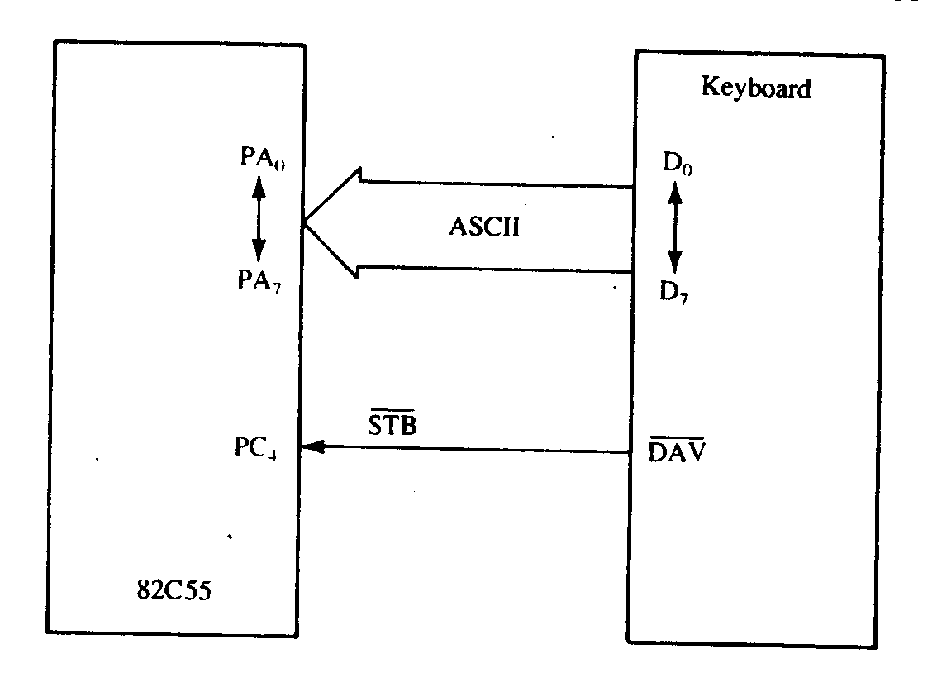
Mode 1 Strobed Input Example ( Keyboard)
The keyboard encoder de‑bounces the key‑switches and provides a strobe signal whenever a key is depressed and the data output contain the ASCII‑coded key code.
Here DAV (data available) is activated for 1 μs each time that a key is typed on the keyboard. Each time a key is typed, therefore, it is stored into port A of the 82C55. The STB input also activates the IBF signal, indicating that data are in port A.

Slide 17
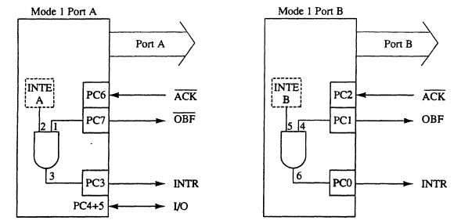
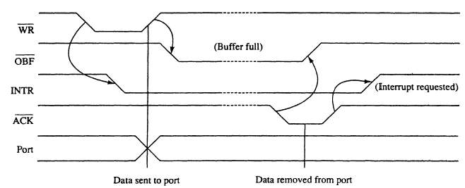
Mode-1 Strobed Output

Slide 18
Timing diagram
Whenever data are written to a port programmed as a strobed output port, the OBF (output buffer full) signal becomes a logic 0 to indicate that data are present in the port latch. This signal indicates that data are available to an external I/O device that removes the data by strobing the ACK (acknowledge) input to the port. The ACK signal returns the OBF signal to a logic 1, indicating that the buffer is not full.

Slide 19
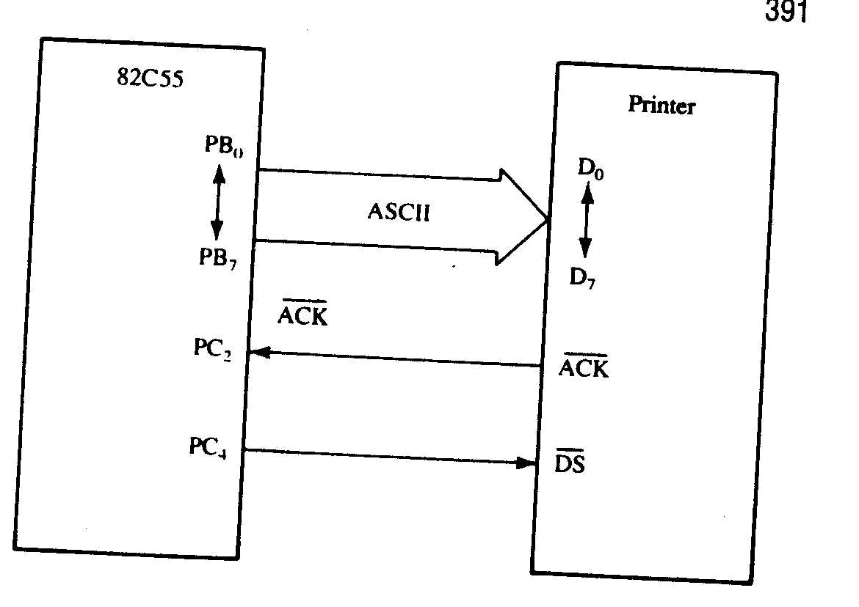
Mode 1 Strobed Output Example ( Printer)
Figure illustrates port B connected to a parallel printer with eight data inputs for receiving ASCII‑coded data, a DS (data strobe) input to strobe data into the printer, and an ACK output to acknowledge the receipt of the ASCII character.
In this circuit, there is no signal to generate the DS signal to the printer. So PC4 is used with software that generates the DS signal. The ACK signal that is returned from the printer acknowledges the receipt of the data and is connected to the AM input of the 82C55.

